Slide 1
Programming of the 2D FE-Implementation of the Stefan Problem and the Enthalpy Problem
Omkar Kolekar (66808)
Supervisor :- Dr. Stefan Prüger

Slide 2
Motivation and Introduction
Complex Geometries
Unconventional Manufacturing and processes involving Phase Change
Expensive experimentation
Simulations!
Mesh manufactured on Laser Powder Bed Fusion .
[1]
Notes:
Complex geometries require unconventional manufacturing processes, such as additive manufacturing, laser powder bed fusion, etc., often involving material phase change.
High cost of manufacturing leave limited room for extensive physical experimentation.
Simulation offers a cost-effective alternative for conducting experiments, providing valuable insights and optimization opportunities.

Slide 3
Modelling and Theory
Enthalpy Problem (Fixed Grid Method)
Amorphous Material (No sharp melting point)
Crystalline Material (Sharp Melting Point)
Two Approaches as follows: -
Stefan Problem (Front Tracking Method)
Crystalline materials (Sharp Melting Point)
Notes:
Two approaches are modelled here, The detail mathematical description given in the report

Slide 4
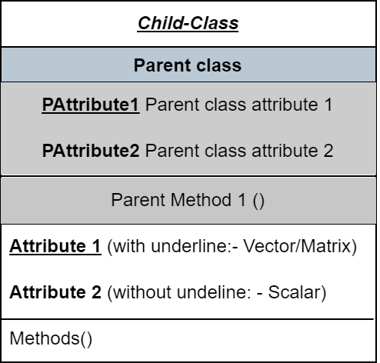
OOP and Structure of class
Attributes
One argument passing of attributes and methods possible
Inheritance
Avoids repetition of same functions and variables
Hiding
Defines the objective of the instance clearly
Ease of communication
Prevents unintentional altering of variables and functions
Scope limited to class
Avoids interchanging of variables and methods
Notes:
Class blue-print for an object or instance. Instance of a class : - nothing but a collection of variables and functions. Lesser number of variables being passed from function to function. Easier communication between functions. Hiding and Privatisation of some functions is possible so that tests can’t be changed.

Slide 5
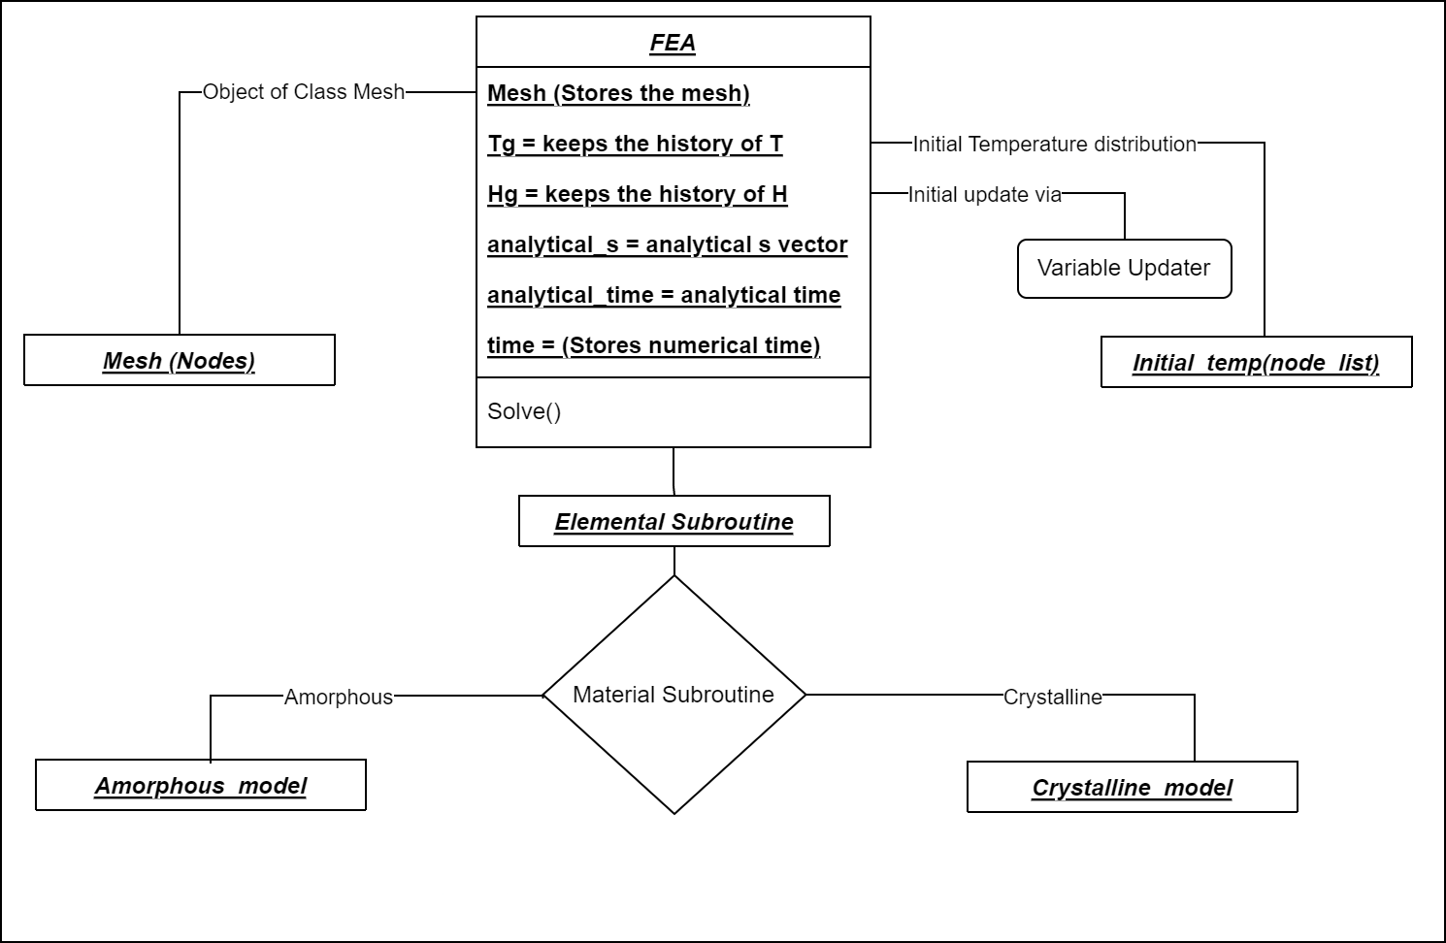
Enthalpy Approach Overview
Notes:
Enthalpy Problem
Is a fixed domain method and applies to the whole domain regardless of the phase at a particular material point.
Requirement of the position of the phase front in the calculation is relaxed.
Stefan Problem
Challenges: changing boundaries with every time step leading to changing domains and non-stationary node points.
This model is used to study the dynamics of the phase change, such as the phase change velocity.

Slide 6
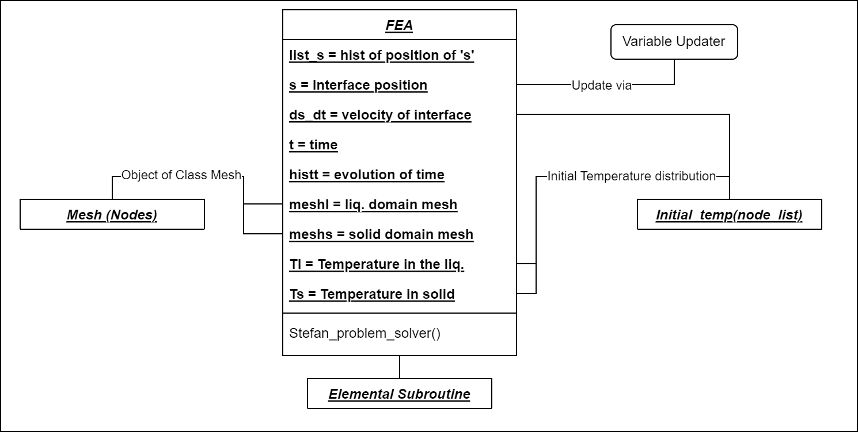
Stefan Problem Overview

Slide 7

Unit Testing
Amorphous Material Temperature Enthalpy Slope Definition: -
* H = 0
Starting point of phase change
* H just > 0
* H just < Hliq
Phase change just started
Phase change just about to finish
* H > Hliq
Phase change completed
Material in liquid regime
Inputs | Status
-1, Hliq+0.5 | Pass
0, Hliq
0.000001, Hliq + 0.000001
0, Hliq-0.000001
$$\frac{dT}{dH}= \left\{\begin{aligned}\frac{1}{D}, H<0 \\ \frac{Tliq}{DTliq + D λ}, 0≤H ≤Hliq \\ \frac{1}{D}, H>Hliq\end{aligned}\right.$$

Slide 8
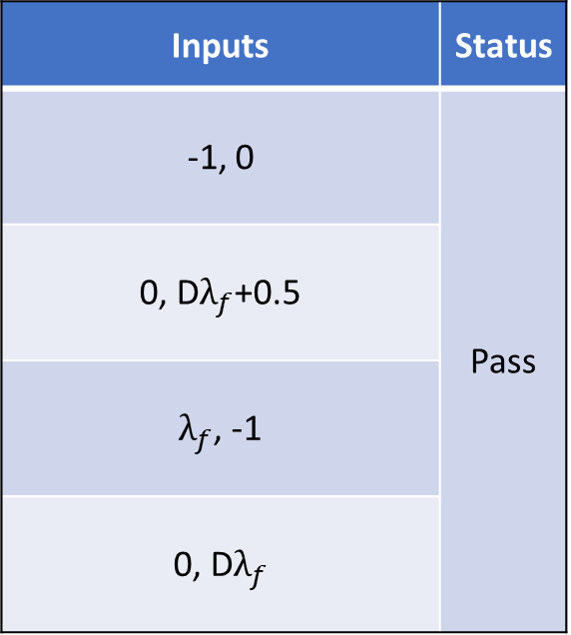

Unit Testing
Crystalline Material Temperature Enthalpy Slope Definition: -
* H < 0
Starting point of phase change
*H = 0
*H = D$λ_{f}$
*H = 0
*H = Dλ_𝑓
Phase change started
Phase change finish
* H > D$λ_{f}$
* H > Dλ_𝑓
Phase change completed
Material in liquid regime
Inputs | Status
-1, 0 | Pass
0, D$λ_{f}$+0.5
$λ_{f}$, -1
0, D$λ_{f}$
$$\frac{dT}{dH}= \left\{\begin{aligned}\frac{1}{D}, H<0 \\ 0, H=Dλ_{f} \\ \frac{1}{D}, H>Dλ_{f}\end{aligned}\right.$$

Slide 9
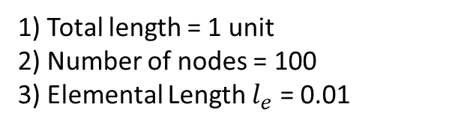


Unit Testing
Mesh: - Testing the Derivative of Shape Function
Mesh: - Testing the Shape Function
Mesh: - Testing the Jacobian
1) Total length = 1 unit
2) Number of nodes = 100
3) Elemental Length $l_{e}$ = 0.01
Inputs | Outputs
 | Expected | Obtained
[2, 1] | -100 | -100
[1,3] | 200 | 200
[4,4] | 0 | 0
$$\frac{dN}{dx}\acute{T}= \frac{T_{2} − T_{1} }{x_{2}−x_{1}}$$
The sum of the shape function should be = 1 within the element, irrespective of the value of the local co-ordinate.
$$\sum_{i=1}^{2}{N_{i}= }N_{1}+ N_{2}=1$$
Local Co-ordinate passed ξ = 0.5, output = 1 Hence, Passed.
In 1D settings: - for the given mesh, we expect the output for the element 2 to be $\frac{x_{3}−x_{2}}{2}$, $\frac{0.03−0.02}{2}=0.005$ Status: Pass

Slide 10
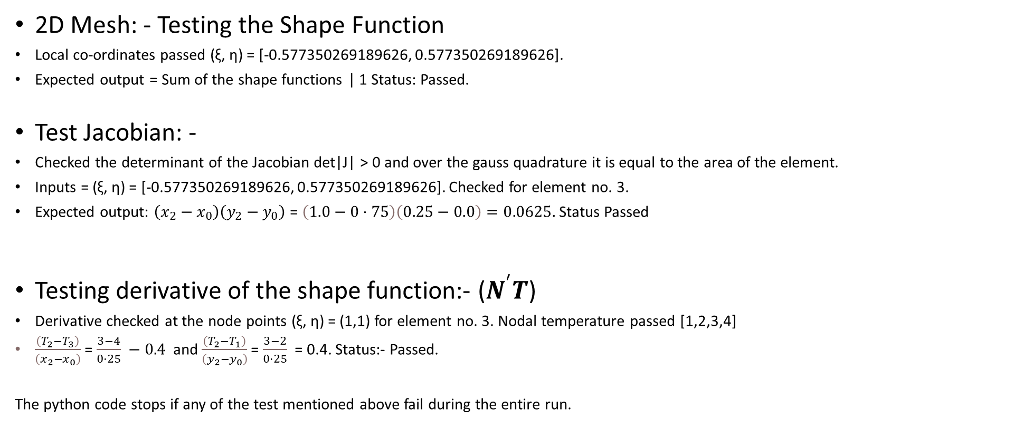
Unit Testing
2D Mesh: - Testing the Shape Function
Local co-ordinates passed (ξ, η) = [-0.577350269189626, 0.577350269189626].
Expected output = Sum of the shape functions | 1 Status: Passed.
Test Jacobian: -
Checked the determinant of the Jacobian det|J| > 0 and over the gauss quadrature it is equal to the area of the element.
Inputs = (ξ, η) = [-0.577350269189626, 0.577350269189626]. Checked for element no. 3.
Expected output: $\left(x_{2}−x_{0}\right)\left(y_{2}−y_{0}\right)$ = $\left(1.0−0⋅75\right)\left(0.25−0.0\right)=0.0625.$ Status Passed
Testing derivative of the shape function:- ($N^{′}T$)
Derivative checked at the node points (ξ, η) = (1,1) for element no. 3. Nodal temperature passed [1,2,3,4]
$\frac{\left(T_{2}−T_{3}\right)}{\left(x_{2}−x_{0}\right)}$ = $\frac{3−4}{0⋅25} −0.4$ and $\frac{\left(T_{2}−T_{1}\right)}{\left(y_{2}−y_{0}\right)}$ = $\frac{3−2}{0⋅25}$ = 0.4. Status:- Passed.
The python code stops if any of the test mentioned above fail during the entire run.
Notes:
Tested the partition of unity property.

Slide 11
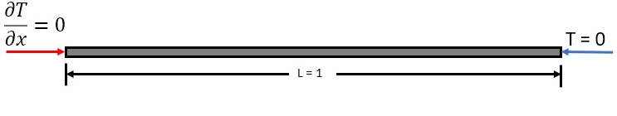
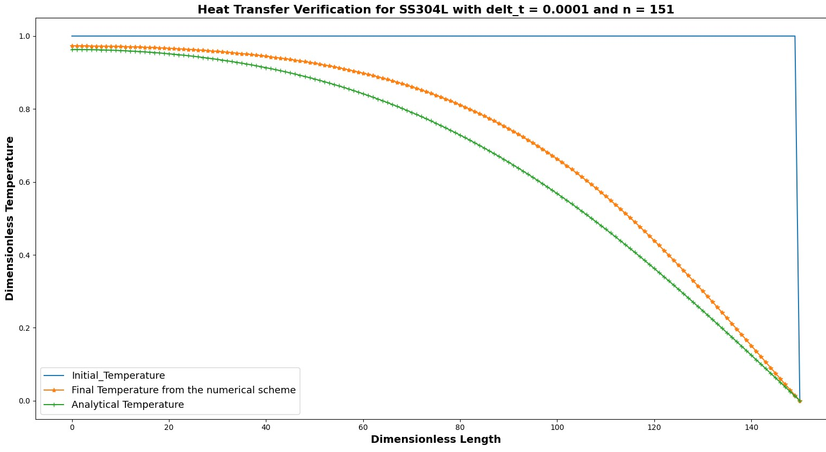
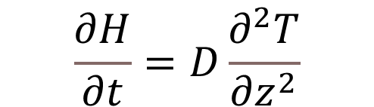
Validation: Heat Transfer
$$\frac{∂H}{∂t}=D\frac{∂^{2}T}{∂z^{2}}$$
All Unit Tests Passed
Heat Transfer Verification acceptable?
Incorrect Final Results
Requirement of another Test!
Stability Issues?

Slide 12
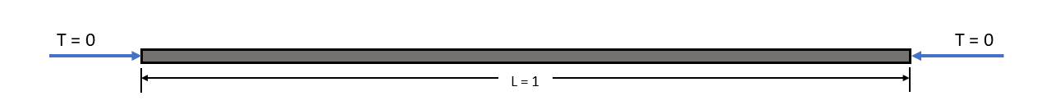
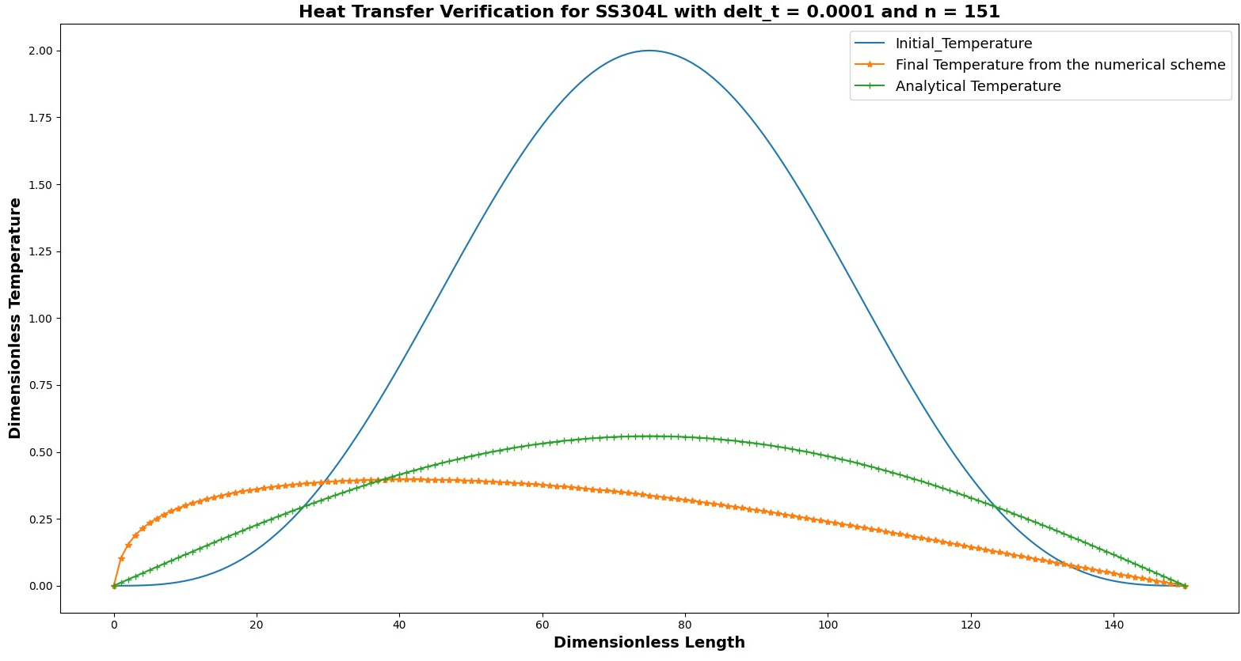
Validation: Heat Transfer
Shift in graph: Validation Failure
All Unit Test Passed!
Boundary Condition check!
Concept of OOP? -> Problem Identified!
Notes:
While Object-Oriented Programming can be advantageous for passing attributes and methods, it’s important to be aware that, unlike functions where the scope of a variable is limited to within the function, and the variable is lost once the function is completed, the attributes of a class are not lost and retain the data from the previous calculation unless explicitly reset or reinitialized. This also highlights the importance of the testing and verification of the code for various cases.

Slide 13
Final Results: - 1D Enthalpy Amorphous Mat.
All Tests and Verifications Passed!

Slide 14
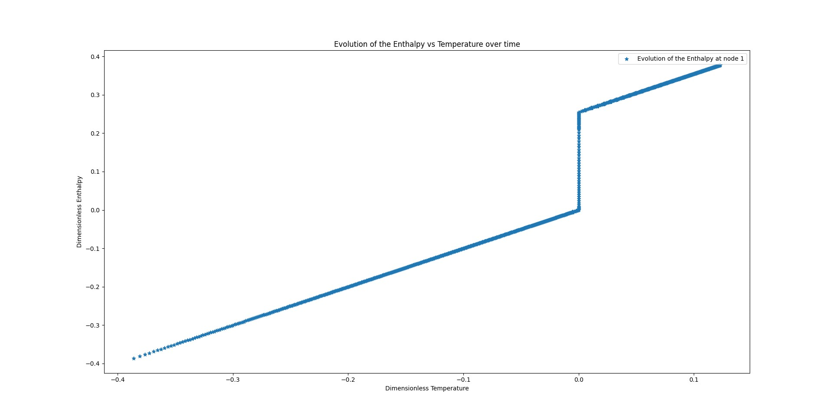
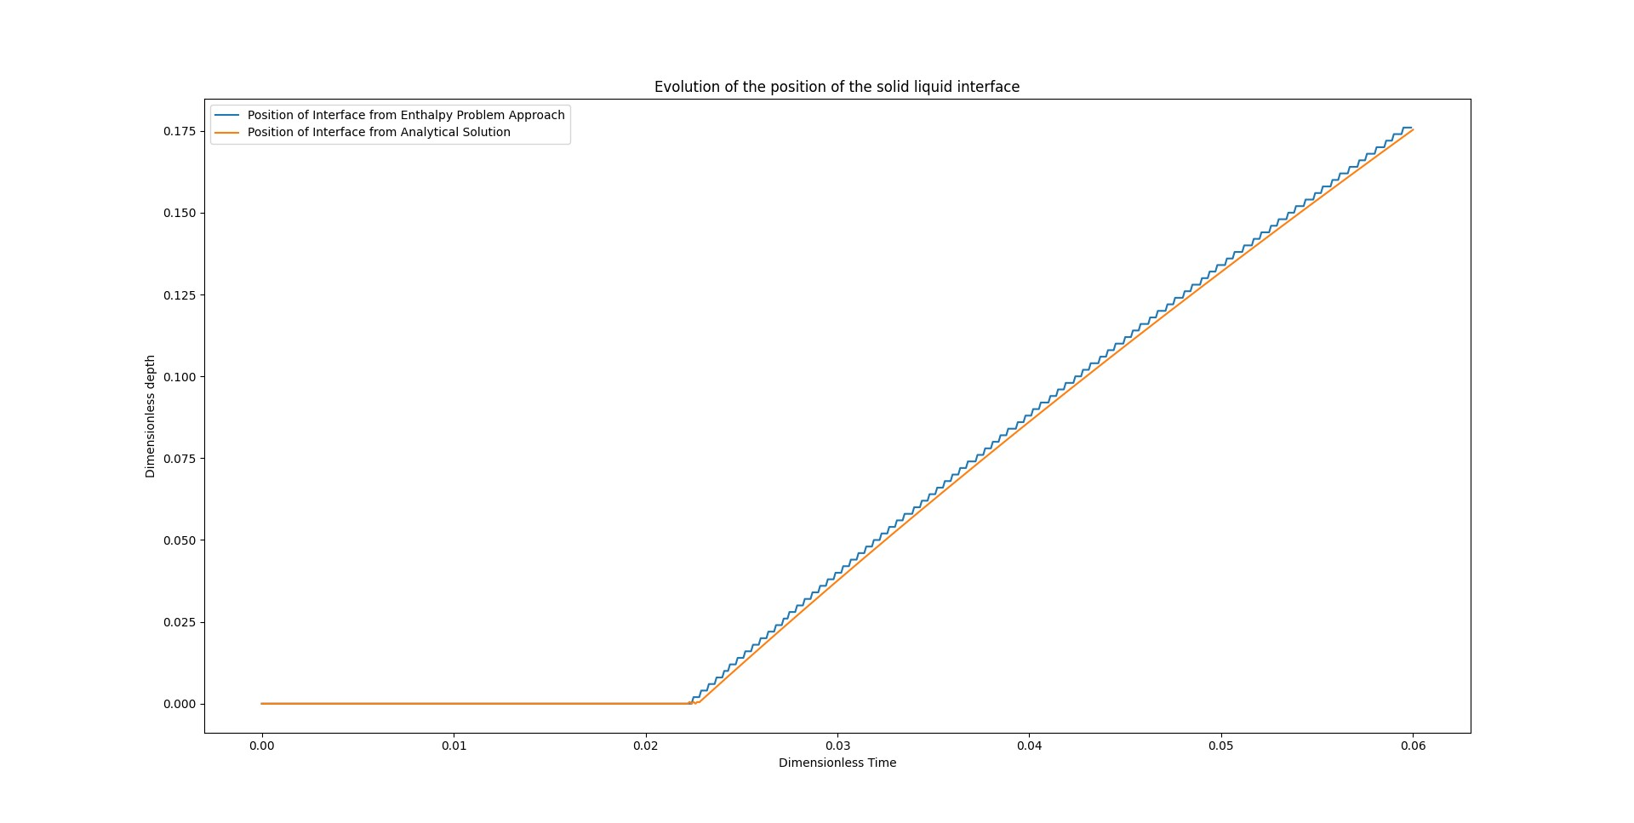
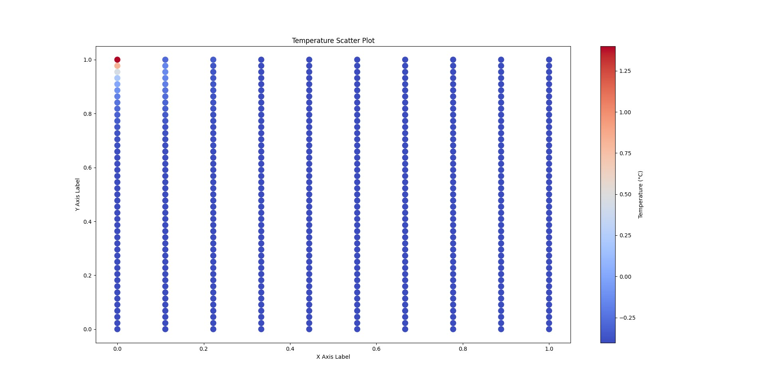
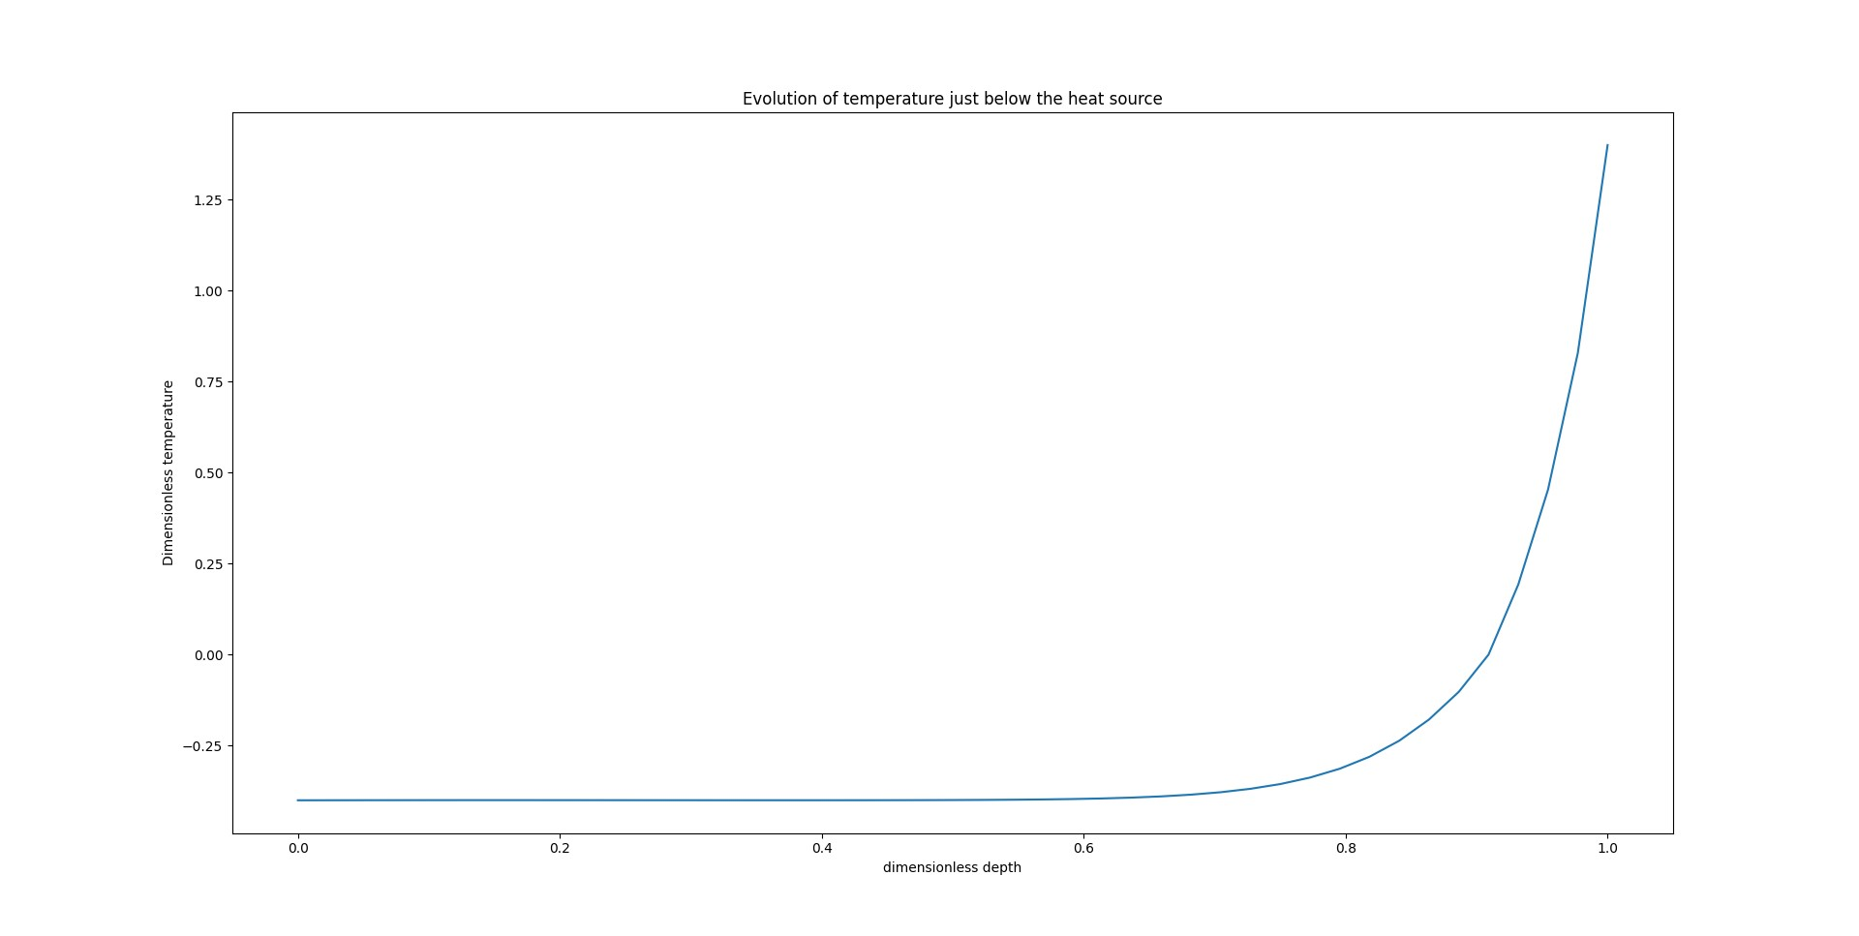
Final Results: - Enthalpy Crystalline Mat.
Enthalpy Problem 1D results:-
Dimensionless Depth
Dimensionless Enthalpy
Dimensionless Temperature
Dimensionless Time
Enthalpy Problem 2D results:-
Dimensionless Temperature
Dimensionless Depth
Dimensionless Depth
Dimensionless Width

Slide 15
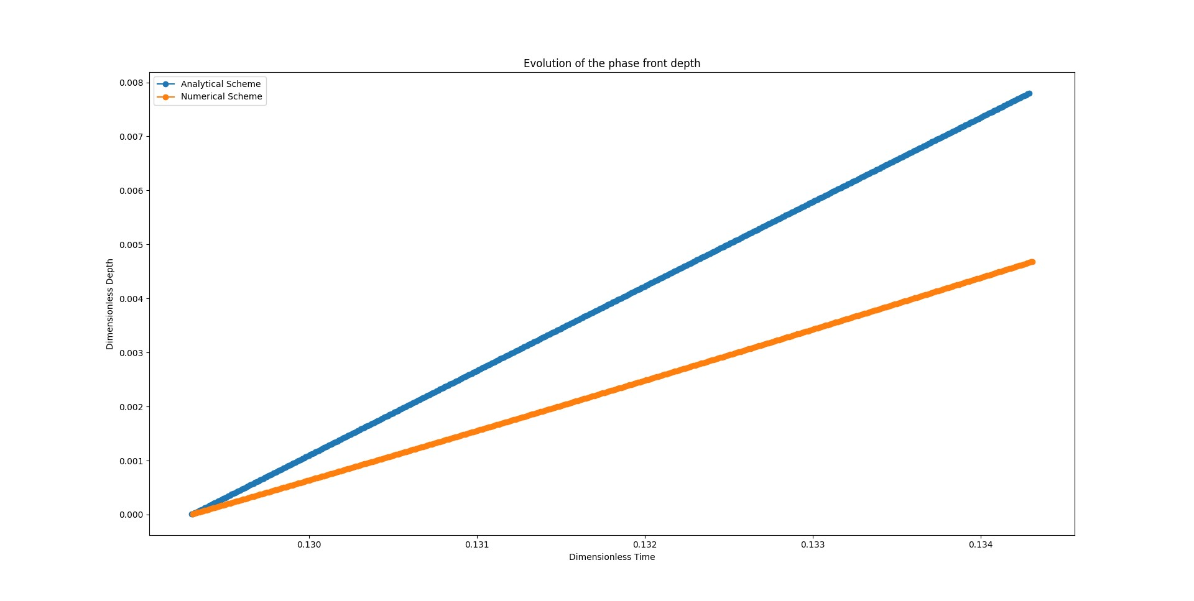
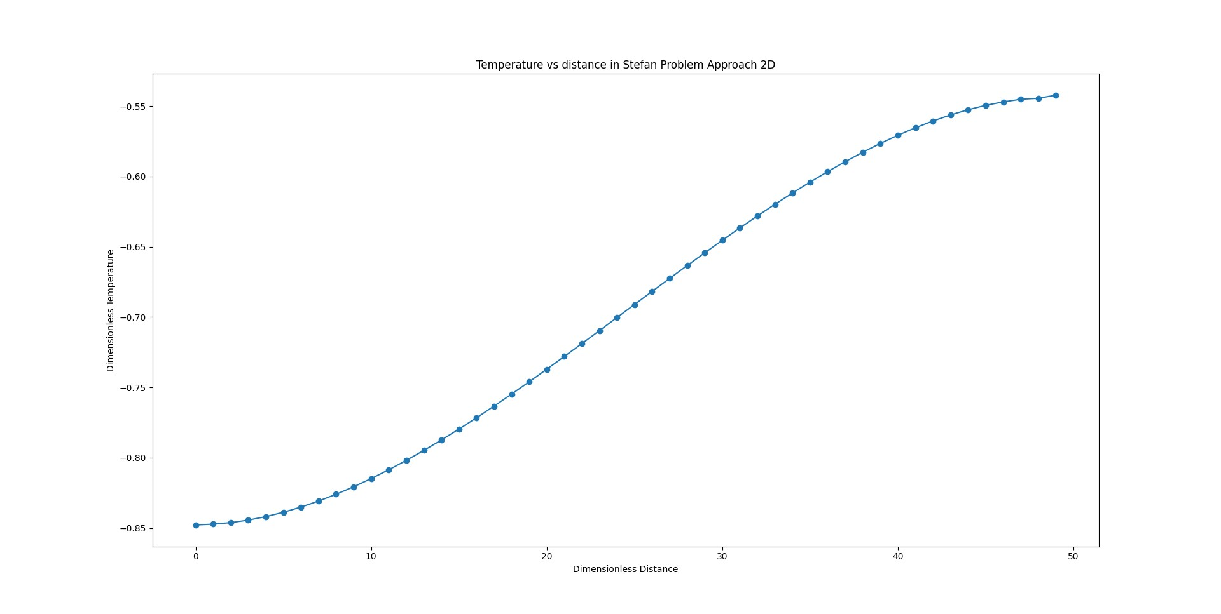
Stefan Problem Results
Stefan Problem 1D results:-
Stefan Problem 2D results:-
Notes:
Problem with the Stefan 2D problem:- Velocity being scalar!

Slide 16
Specifics of the program
No assembly Matrices
Fast
Efficient
Internalised Tests
Break if test fails
Saves the results in the attribute
Assembly in a separate method
Possibility of parallelisation
Saves computational Load
[2]

Slide 17
References
Sohini Chowdhury, N. Yadaiah, Chander Prakash, Seeram Ramakrishna, Saurav Dixit, Lovi Raj Gupta, Dharam Buddhi,
Laser powder bed fusion: a state-of-the-art review of the technology, materials, properties & defects, and numerical modelling, Journal of Materials Research and Technology, Volume 20, 2022
[1]
[2]
The python logo. Python.org. (2015). https://www.python.org/community/logos/

Slide 18
Thank you

